Slide 1
ECE 554 final project:
Sega Master System
Group 2: Clement Luk, Eric Jackowski, Ilhyun Kim, Mike Wiktor, Karthik Ramachandran, Tsung-Hao Chen, Tsung-Chi Lin, Yi-Ting Chen, Dan Luu

Slide 2
Outline
1) Objective
2) Team Organization
3) Z-80 processor and instruction set
4) Processor organization and internal ISA

Slide 3
Objective
Goal:Implement Sega Master System
  Processor, Video Processor, Memory Unit, Sound system (optional)
Processor
  Implement Z-80 instruction set and internally translate into RISC-like instruction

Slide 4
Team Organization
Processor Team (4 persons)
  Ilhyun Kim, Eric Jackouski, Yi-Ting Chen, Mike Wiktor
Memory and I/O team (2 persons)
  Tsung-Hao Chen, Tsung-Chi Lin
Graphic Team (3 persons)
  Dan Luu, Clement Luk, Karthik Ramachandran

Slide 5
Z-80 processor
Outline:
  1) Architecture overview
  2) Overview instruction types
  3) Addressing mode
  4) Each instruction type

Slide 6
Z80 processor architecture overview (1)
CISC processor
  Variable length instruction
    (each are 1 byte length, max up to 4 bytes)
  16 bits address bus, 8 bits data bus
  Other signal to interface with I/O and memory

Slide 7
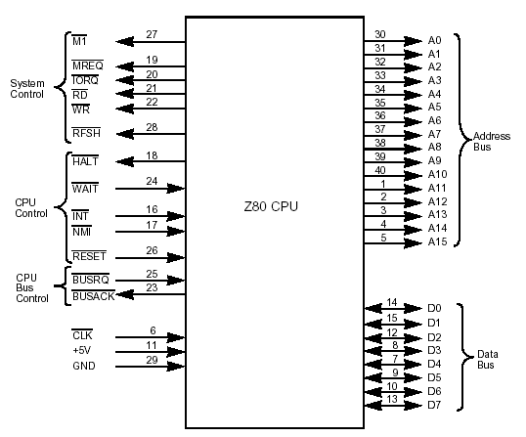

Slide 8
Z80 processor architecture overview (2)
Register
2 sets of 6 general register
  (8 bits or 16 bits as pair)
2 sets of accumulator and flag register
Special registers:
Program Counter, Stack Pointer, Index reg, Interrupt Reg, Memeory refresh reg

Slide 9
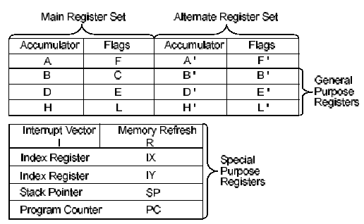
Register (1)

Slide 10
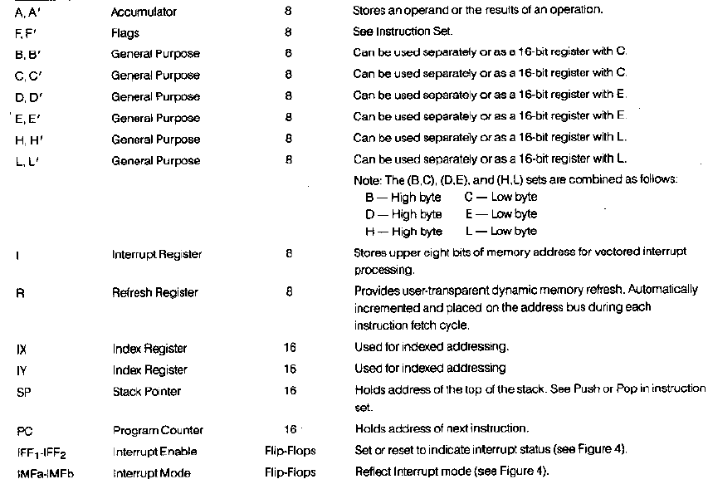

Slide 11
Overview Z-80 instruction types
Total 158 different types, but addressing mode can be mixed
  1) Load and exchange
  2) Block transfer and search
  3) Arithmetic and logical
  4) Rotate and shift
  5) Bit manipulation(Set, Rest, Test)
  6) Jump, call, and return
  7) Input/Output
  8) Basic CPU controul

Slide 12
Z-80 addressing mode
1) Immediate
  Immediate extended
2) Modified page zero
3) Relative addressing
4) Extended adressing
5) Register addressing
  Register indirect
  Indexed adressing

Slide 13

Immediate
1 or 2 bytes op code
1 byte operand

Slide 14

Immediate extended
1 or 2 bytes op code
2 bytes operand

Slide 15
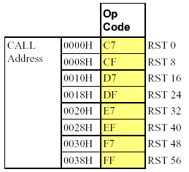
Modified page zero
1 byte op code to address 16 bits location

Slide 16

Relative addressing
Relative jump from current PC

Slide 17

Extended addressing
1 or 2 bytes op code
2 bytes address for jump or location of operand

Slide 18
Register addressing
Register Indirect
1 or 2 bytes
Using register pair(HL, BC, DE) as pointer to memory

Slide 19

Register addressing
Indexed addressing
1 or 2 byte op code
Index reg+displacement

Slide 20

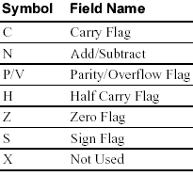
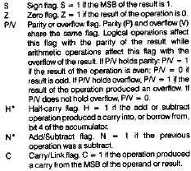
Flag register

Slide 21
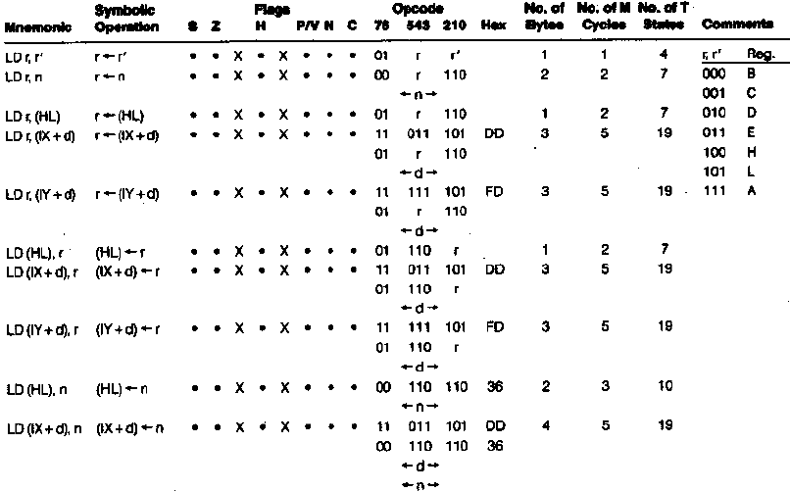

Slide 22

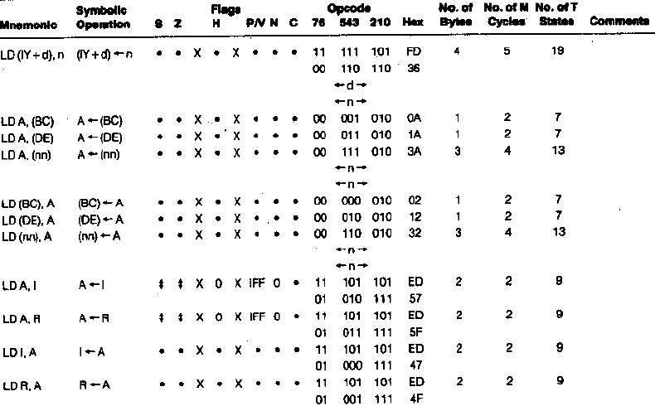

Slide 23
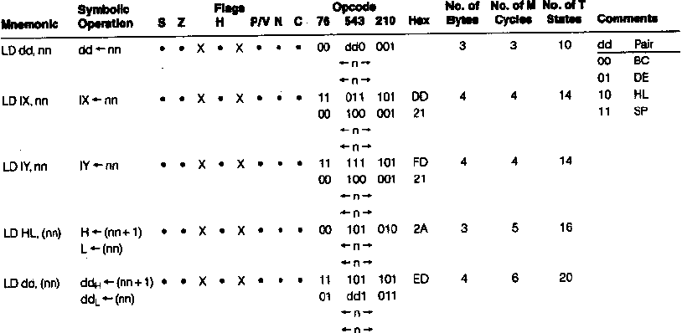

Slide 24
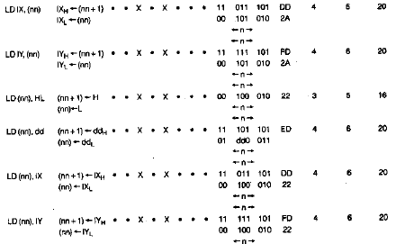

Slide 25
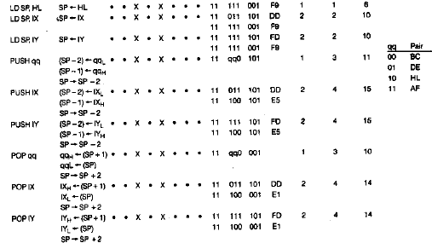

Slide 26
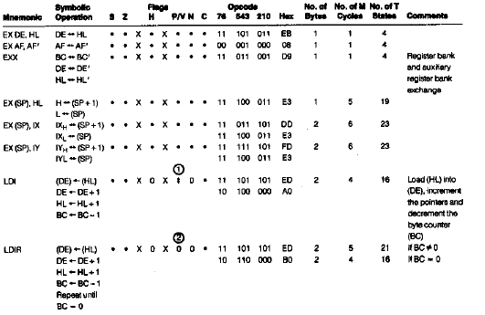

Slide 27
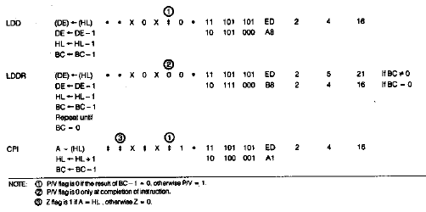

Slide 28
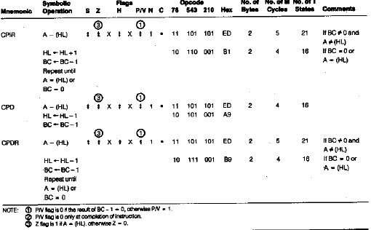

Slide 29
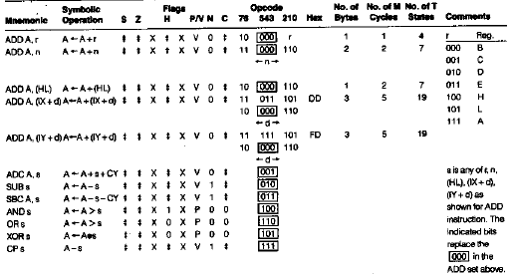

Slide 30
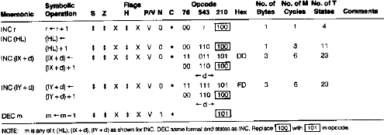

Slide 31
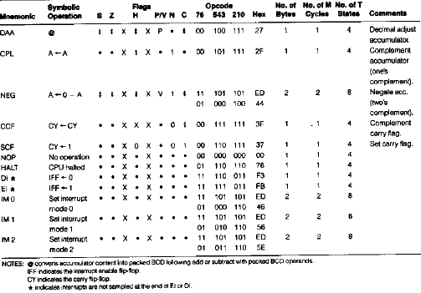

Slide 32
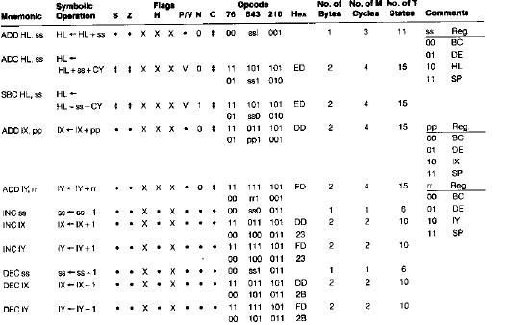

Slide 33
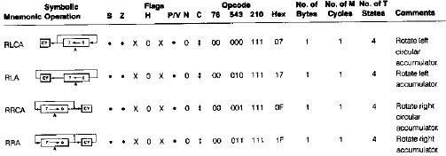

Slide 34
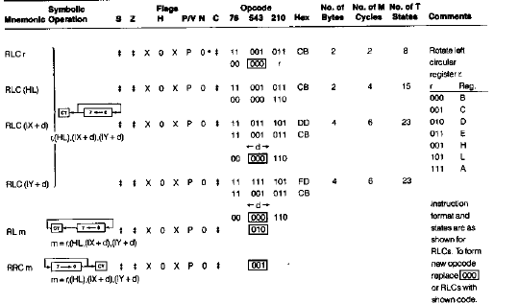

Slide 35
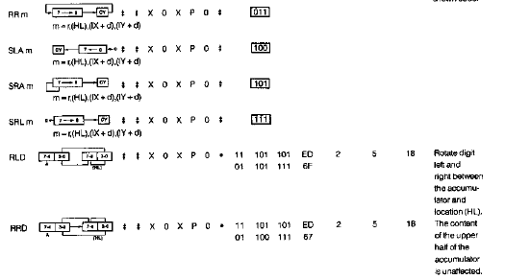

Slide 36
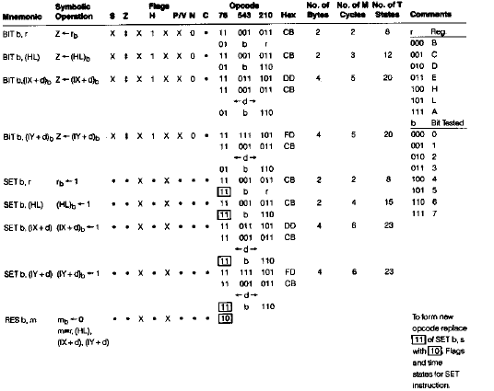

Slide 37
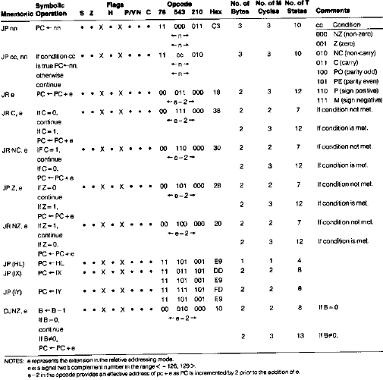

Slide 38
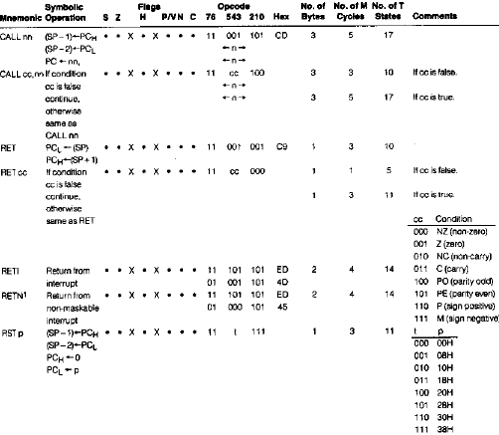

Slide 39
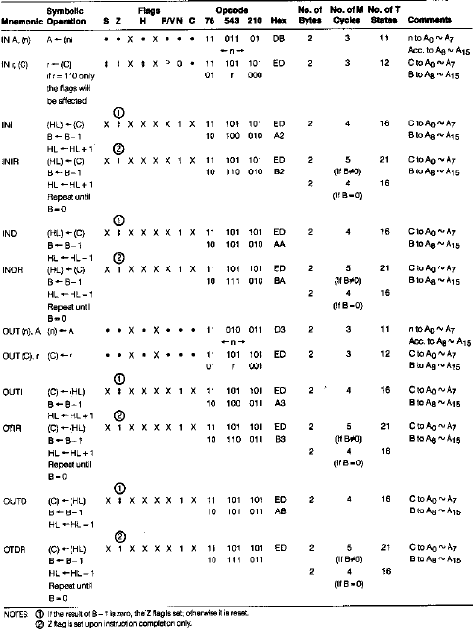

Slide 40
